Slide 1
Modeling Perceptual Decision Making
Slides are based on a lecture by Alfonso Renart and Anne Urai

Slide 2
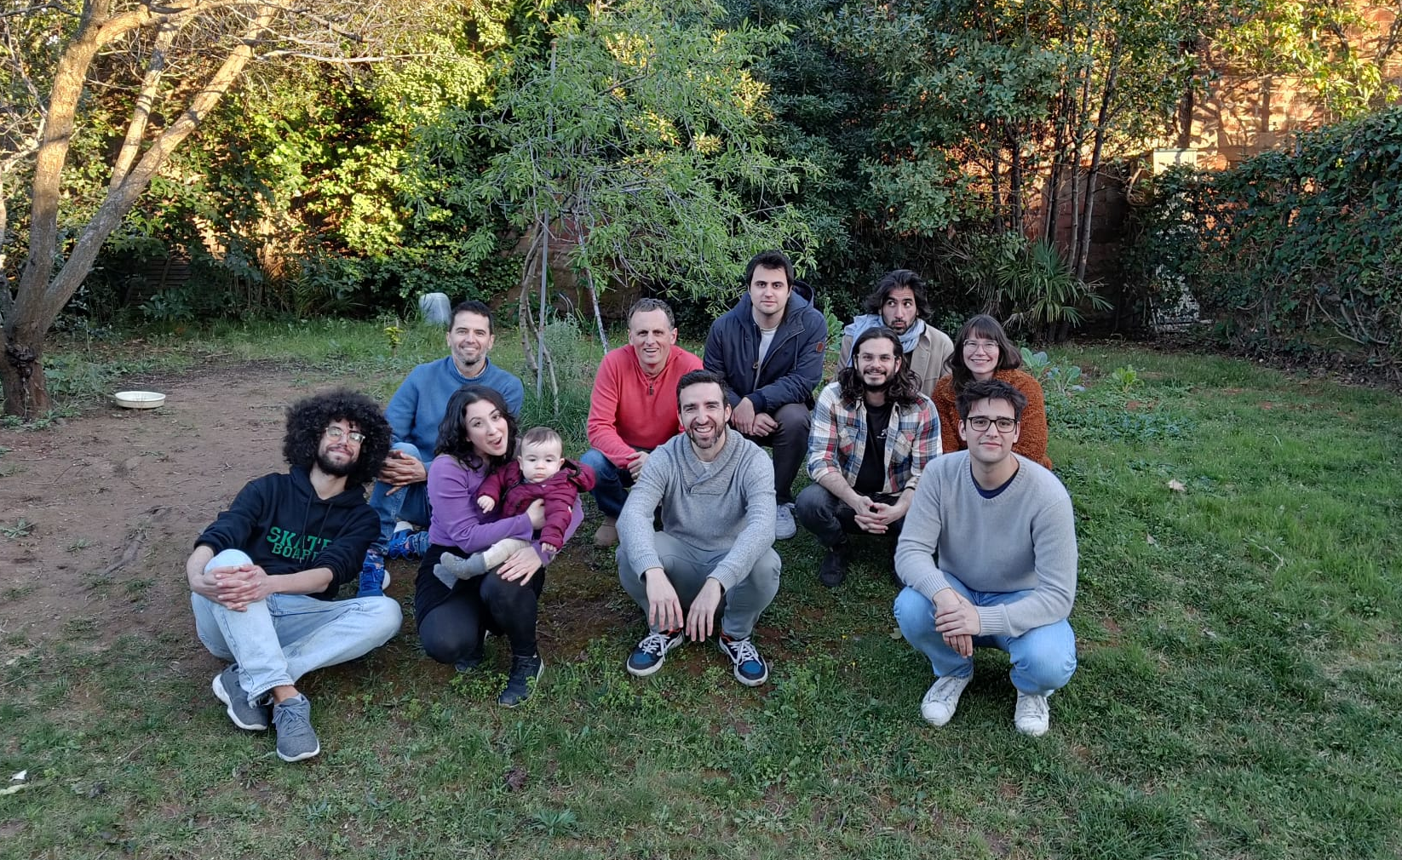
Brain Circuits and Behavior Laboratory IDIBAPS, Barcelona

Slide 3
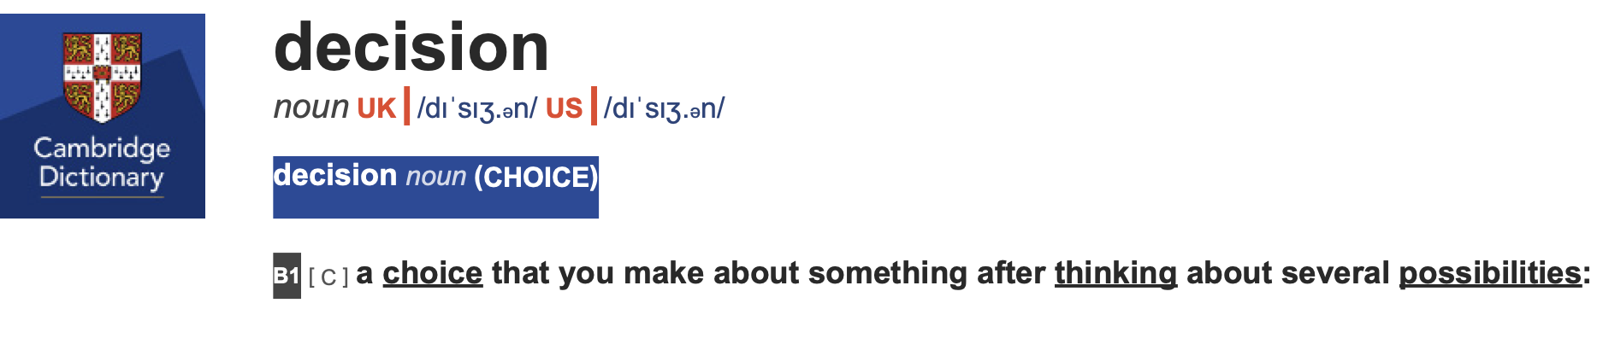
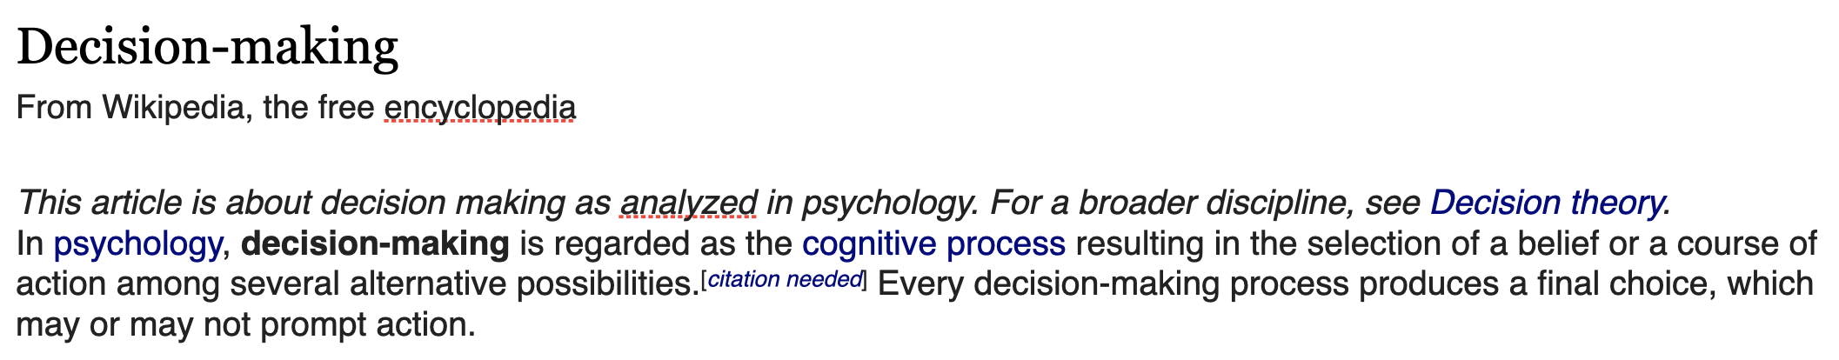
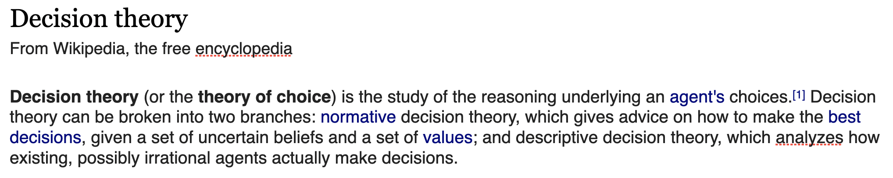
What is a decision?

Slide 4


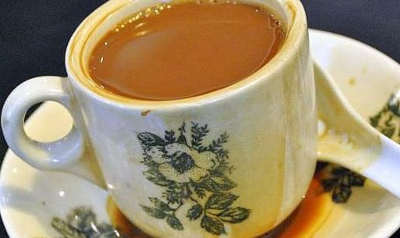
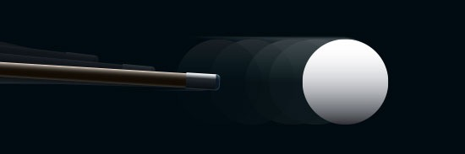
What is a decision?
What type of physical systems make decisions?
coffee + tea!! (made in )
?
Decision-making: The exercise of (causal) agency

Slide 5

What is a decision?
What type of physical systems make decisions?
?
Decision-making: The exercise of (causal) agency
To study it experimentally we need a situation where, given the
environment, there is uncertainty as to which action to select.
Deciding will imply the resolution of that uncertainty by
some process inside the brain’s agent.

Slide 6
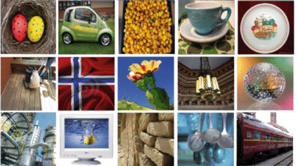
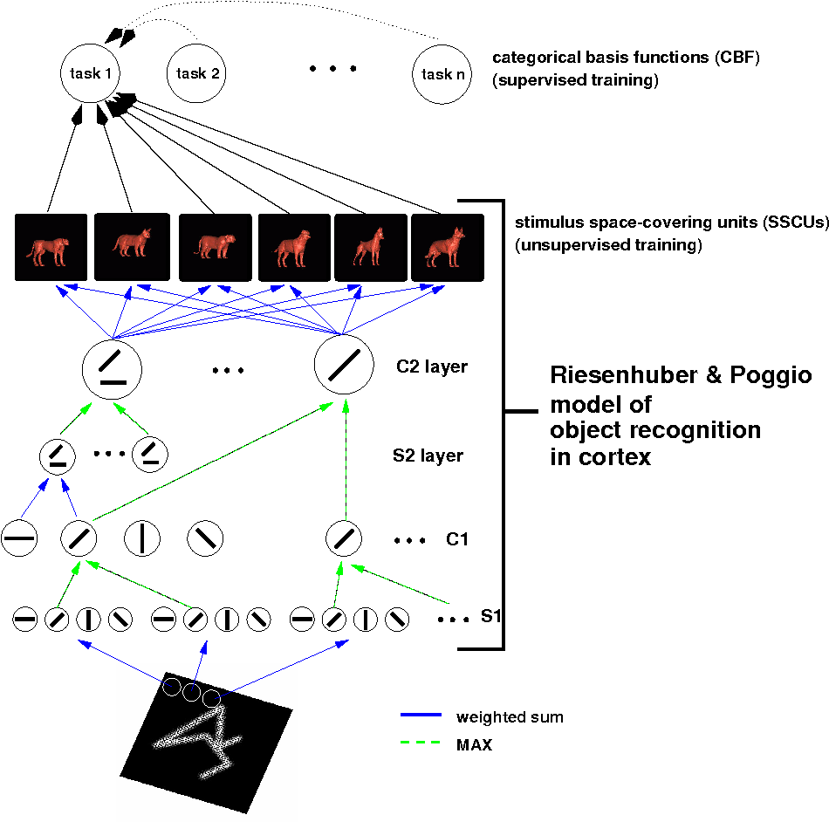

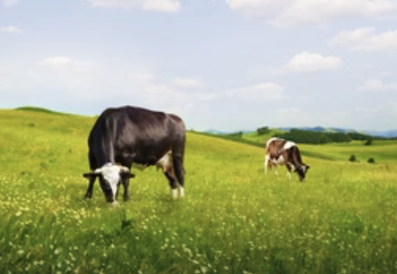
Sensing as measurement
Selectivity
Object recognition involves measuring the magnitude of
category-defining features
object recognition
Size, loudness, time, etc…
give cues for the position
of objects in the environment
Muuuu!!!
Muuuu!!!
An important aspect of “sensing” is measuring the magnitude of simple sensory dimensions/attributes
Length, depth, orientation, loudness, pitch, azimuth, weight, pleasure, pain, temperature, duration, sweetness, odor intensity, color hue/saturation, etc…
Notes:
When we think of perception to typically think of object recognition. However, another important aspect of perception is the ability to measure and compare the magnitude of various simple sensory dimensions.
For instance, in this picture, the size of a cow can be used to infer it’s distance, and in conditions when vision is unreliable, measurements of loudness can be used for the same purpose.

Slide 7
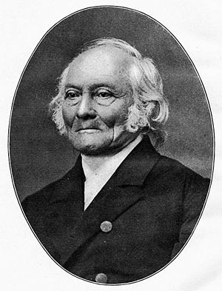
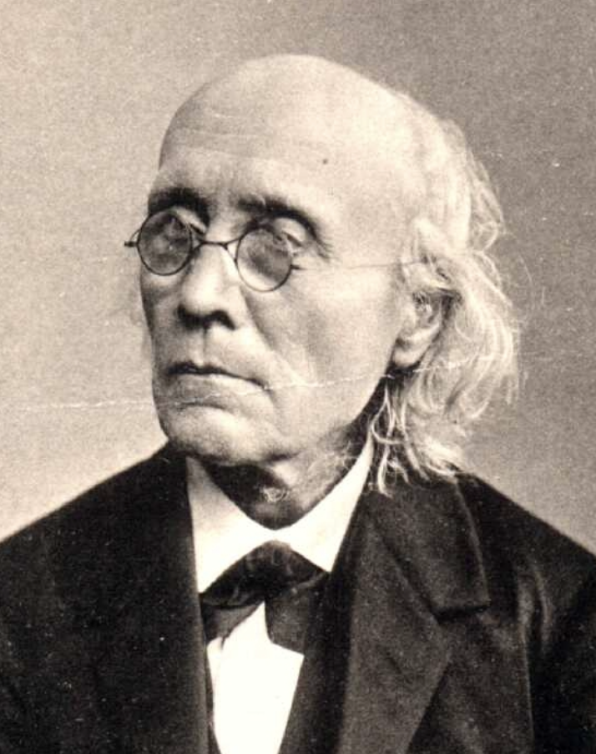
Measuring the accuracy of the perception of a sensory physical magnitude
Weber & Fechner Founders of the field of Psychophysics
Ernst Heinrich Weber (1795-1878)
Gustav Fechner (1801-1887)
Experimental psychology is born through the insight that perception can be thought as measurement and that perception could be measured: Psychophysics
Notes:
Historically, this idea was very important. In fact, exp pay…
The pioneers were Weber and Fechner who, in the first half of the 19th century studied this problem for the first time
The question Weber was interested in was: How diff…

Slide 8
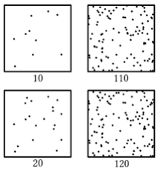

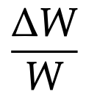
Measuring the accuracy of the perception of sensory magnitude
How different do two sensory stimuli need to be for them to be barely discriminable?
Weight (gr)
75% Correct
75% Correct
240
Just noticeable
difference (JND)
200
120
Psychophysics lies at the interface between sensory neuroscience and behaviour, with an emphasis on behaviours that depend on the perception of sensory magnitude.
100
Weber, 1834
Standard
Standard
Comparison
Comparison
The JND is, in fact, not a difference, but a fractional increment
~ constant = Weber fraction

Slide 9
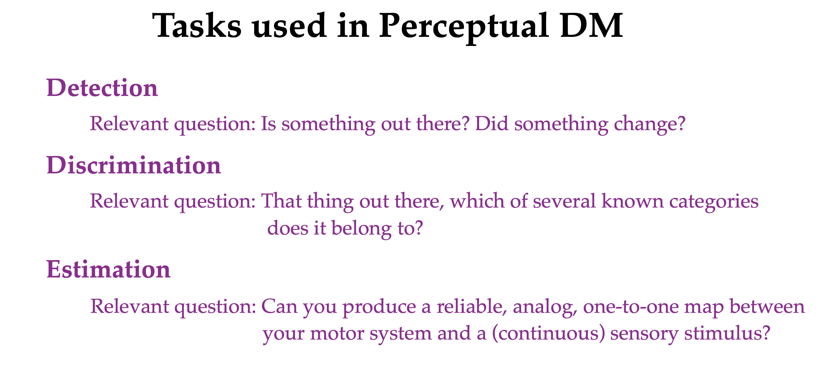
Detection and Discrimination involve ‘categorical choices’ and have been typically conceptualised as forms of hypothesis testing. Common in human and non-human primates and other species.
Estimation involves ‘analog choices’ and is more related to statistical parameter estimation. It is also more sensitive to sensory-motor calibrations. Commonly restricted to human and non-human primates.

Slide 10
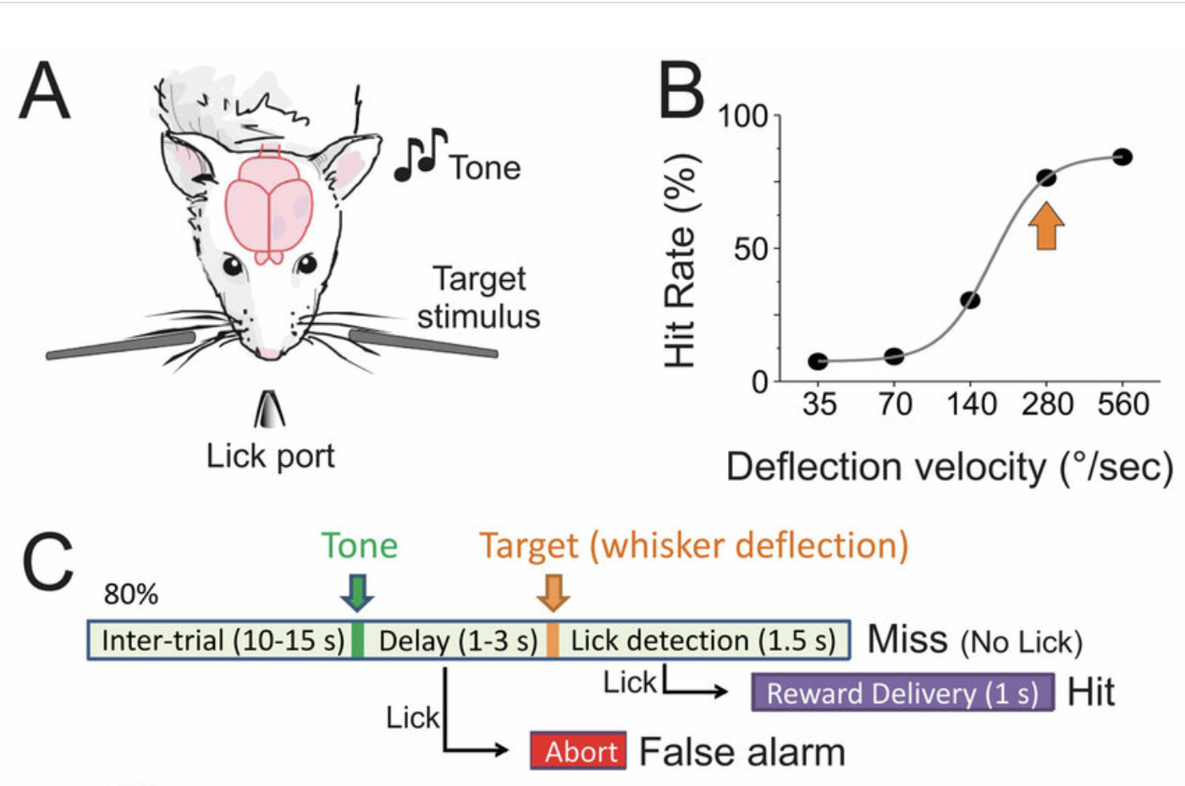
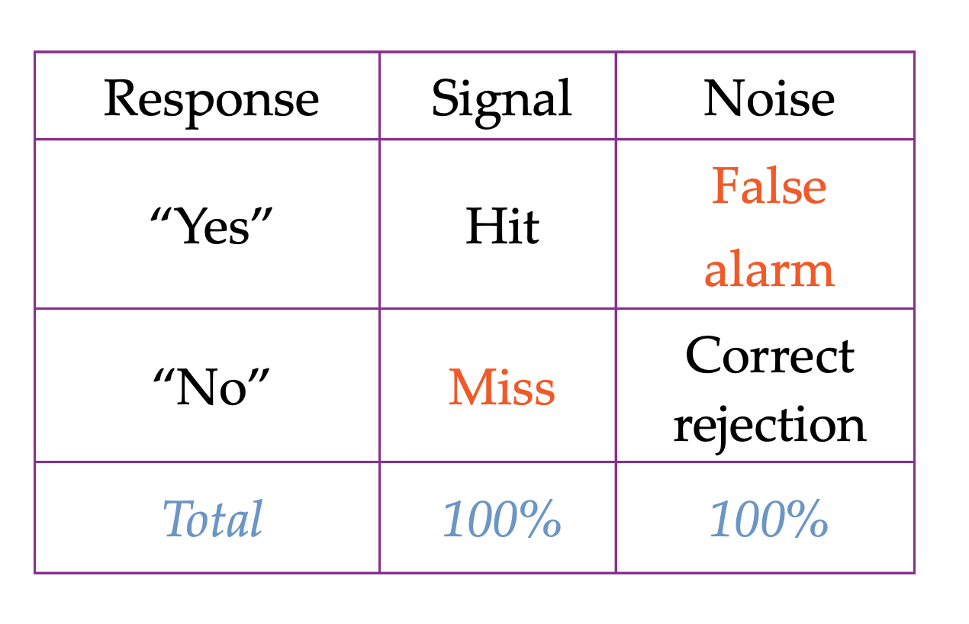
Example of a detection task in rodents
No signal
Because columns sum to 100%, only 2 independent numbers The convention is to use hits (H) and false alarms (FA)

Slide 11
Behavior in H-FA plane
Good
Performance
Responsive
Subject
1
Prob. Hit
Unresponsive
Subject
Random
Choices
0
0
1
Prob. False Alarm

Slide 12
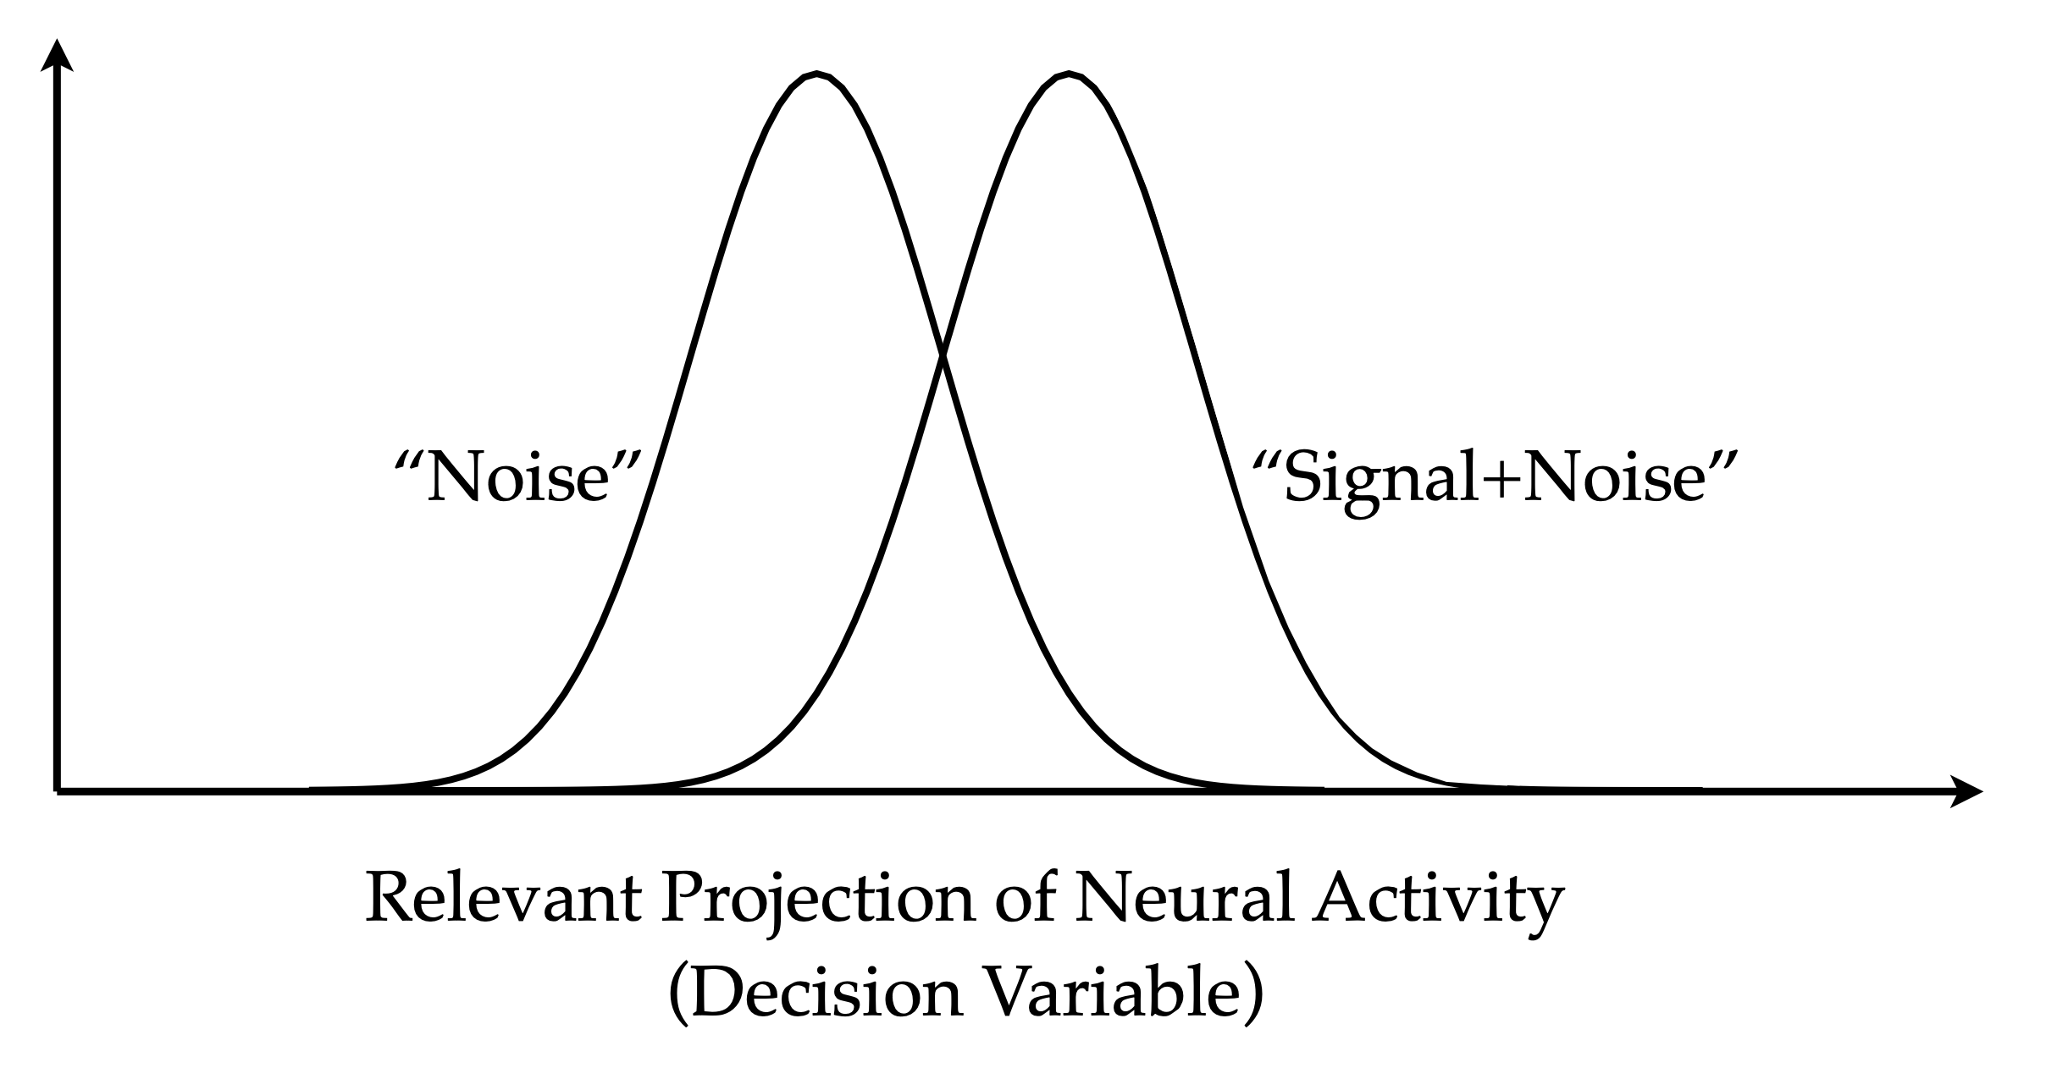
Mechanistic Description for Sensory detection experiments.
The “sensory” aspect of the problem refers to the ability to distinguish these two distributions
Tanner and Swets, Psychological Review 1954

Slide 13
Mechanistic Description for Sensory detection experiments.
The “decision” aspect of the problem has to do with defining a criterion that maps the ‘decision variable’ onto an action.
criterion
Tanner and Swets, Psychological Review 1954

Slide 14
Mechanistic Description for Sensory detection experiments.
criterion
False Alarms
Tanner and Swets, Psychological Review 1954

Slide 15
Mechanistic Description for Sensory detection experiments.
Hits
criterion
Tanner and Swets, Psychological Review 1954

Slide 16
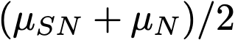
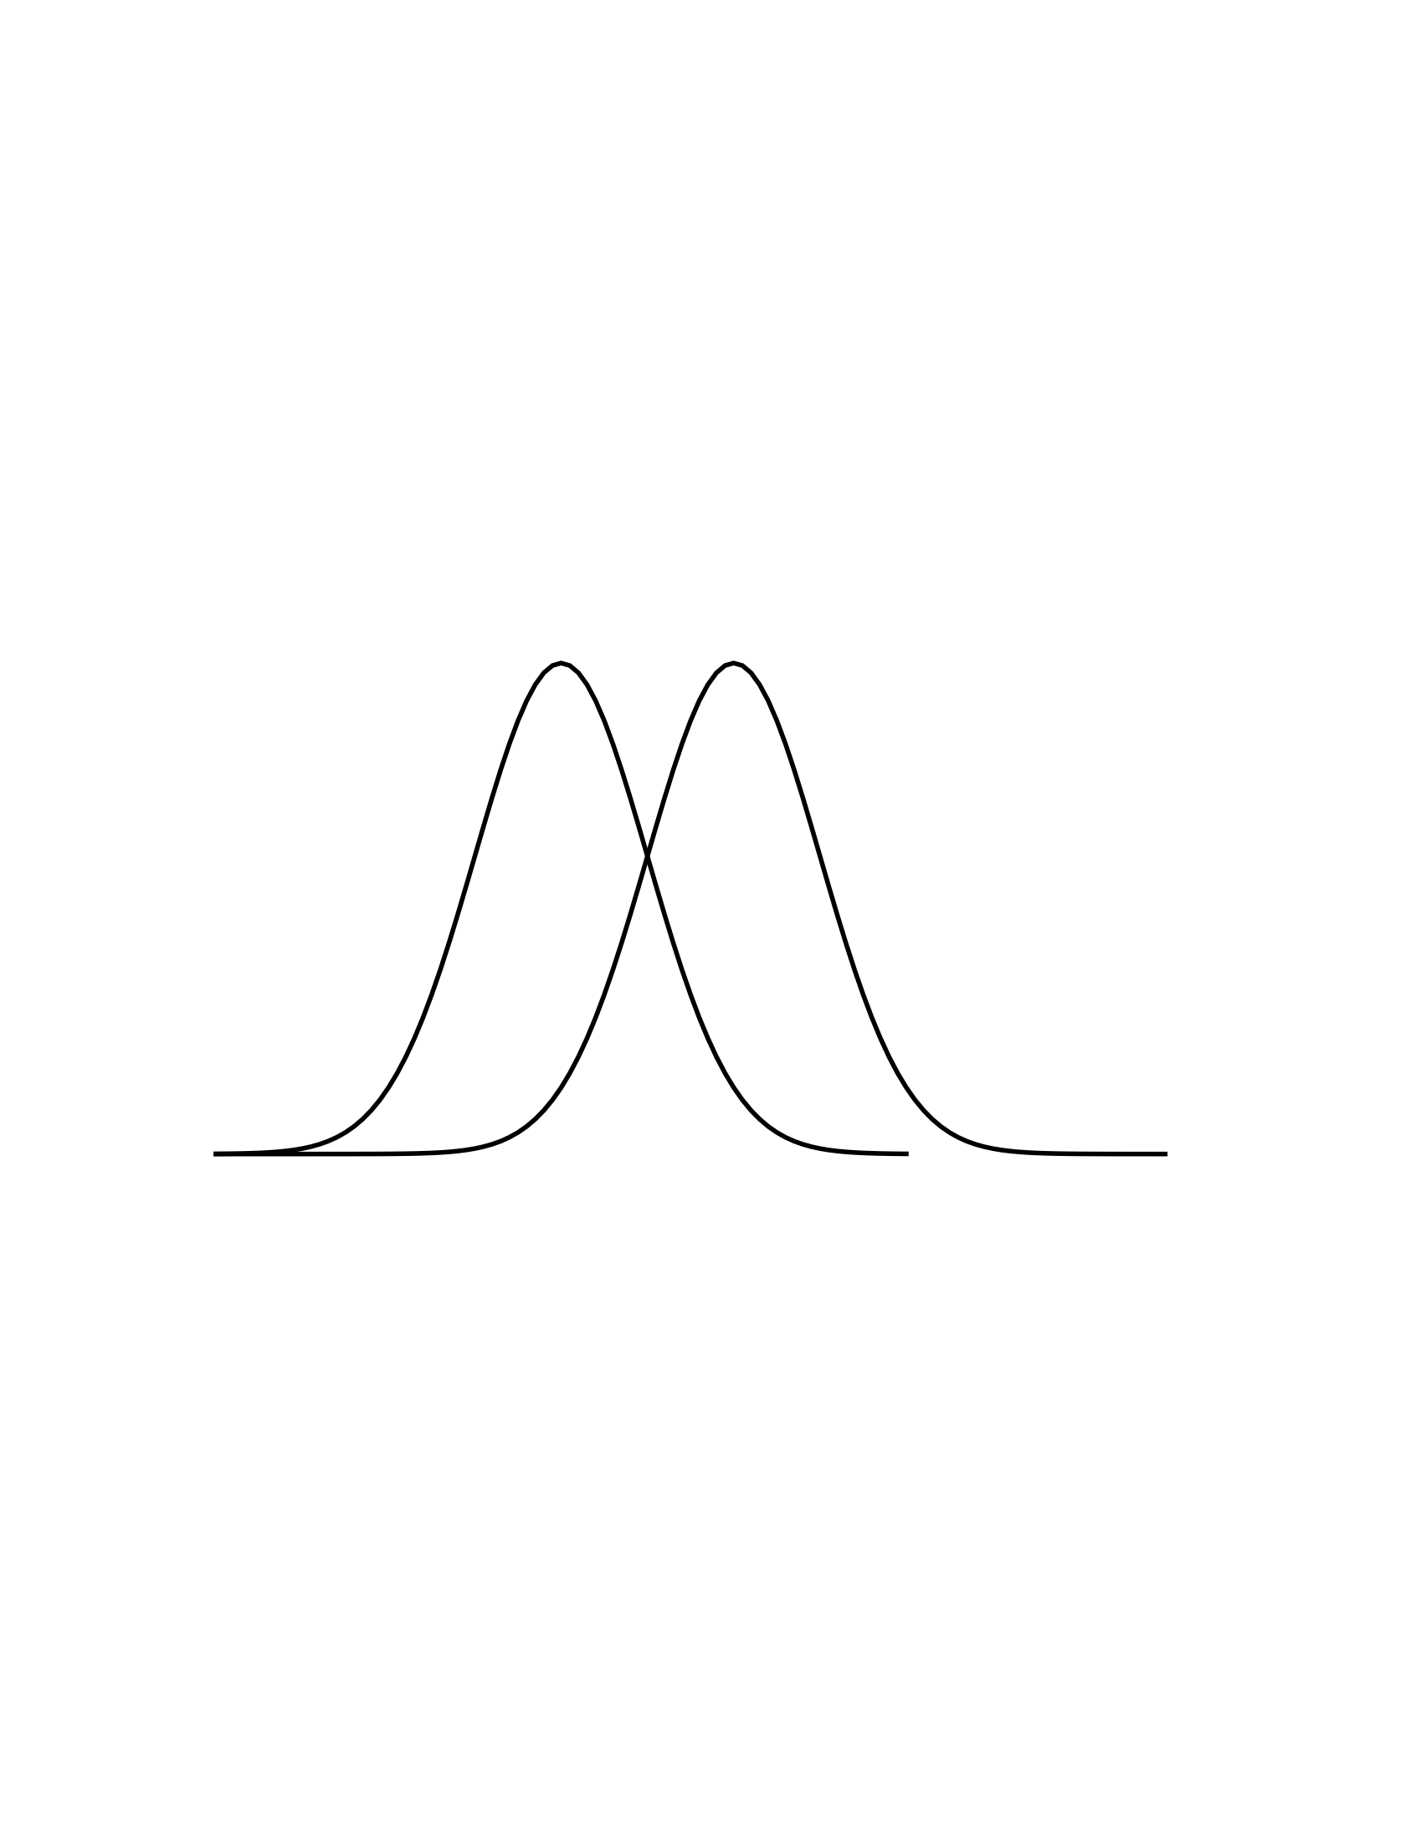
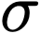
Parameters in SDT: d’ and Bias
Noise+Signal
Noise
Bias
d’
d’ is supposed to represent the true measure of discriminability for a given stimulus strength. It is independent on the subjects strategies.
The criterion c (bias) sets the response tendencies of the subject and can vary depending on various factors such as prior probability of stimulus occurrence, pay-offs, etc…

Slide 17
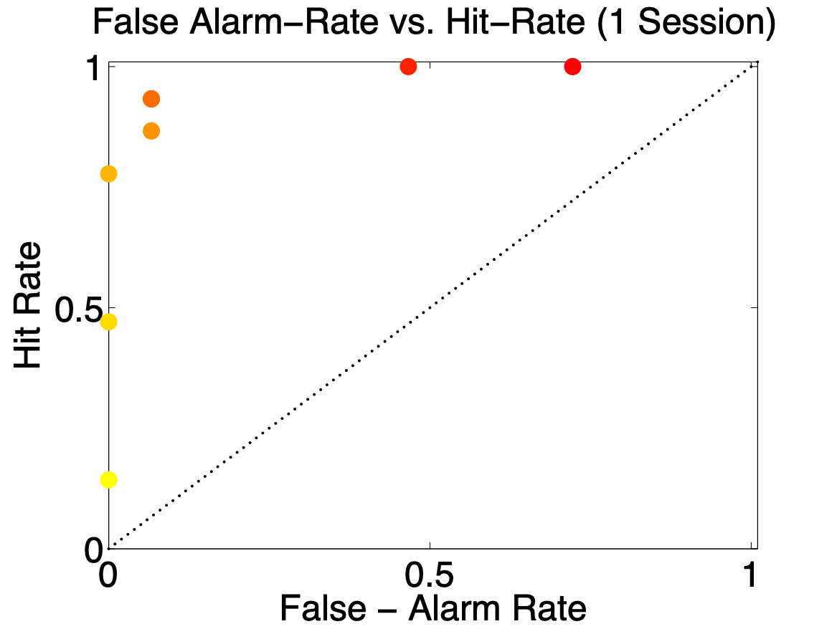
Manipulating the Criterion
(unintended) Value manipulation
Early in the
Session
Late in the
Session
Problem with detection tasks!!

Slide 18
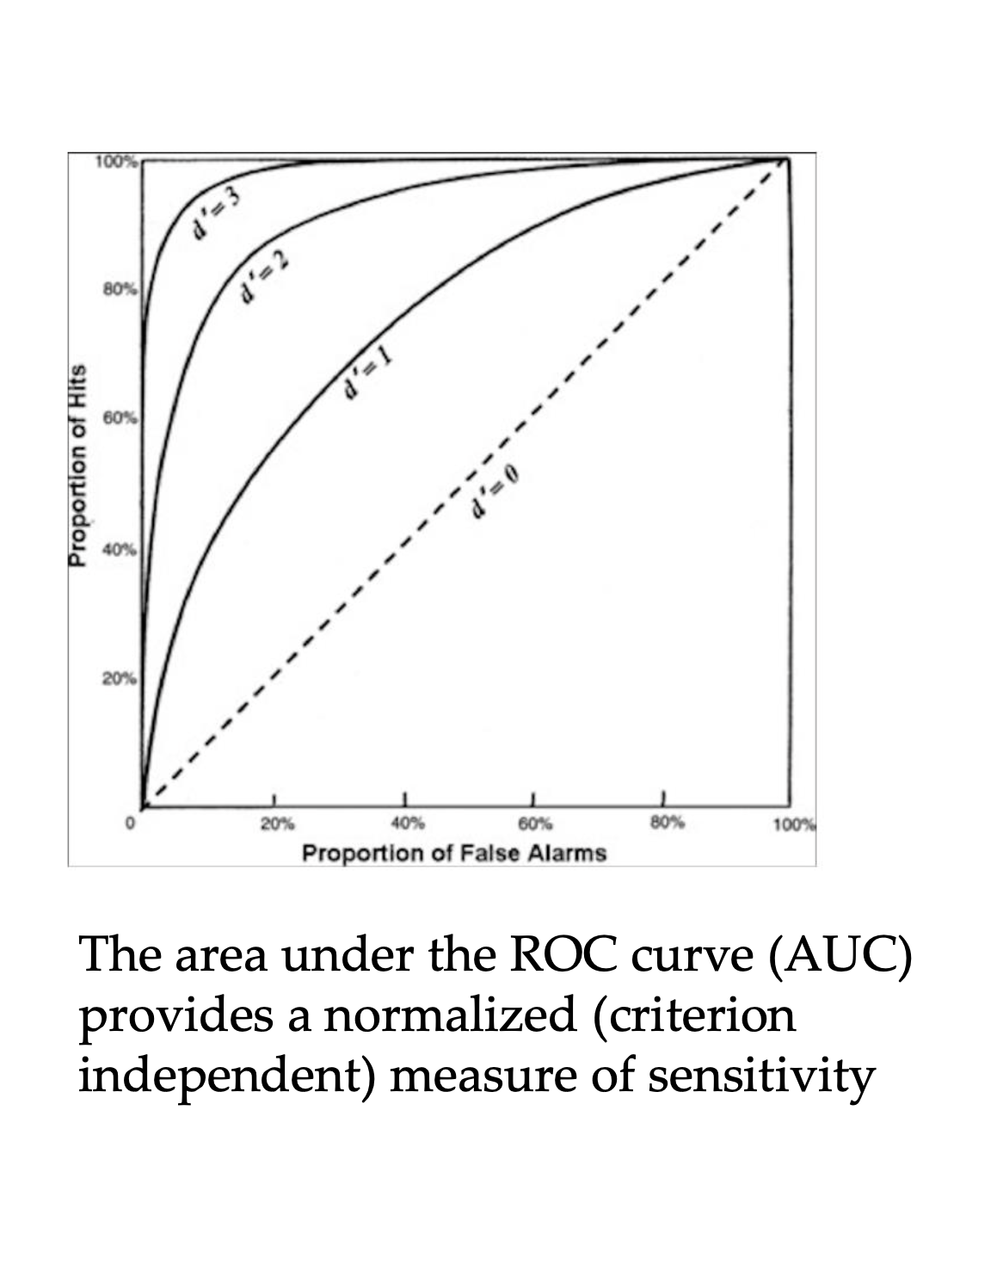
Signal Detection Theory: ROC curve

Slide 19
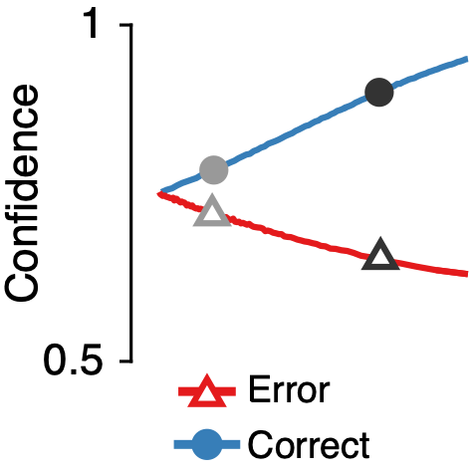
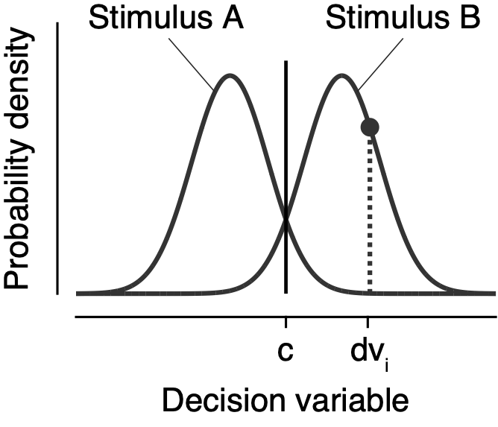
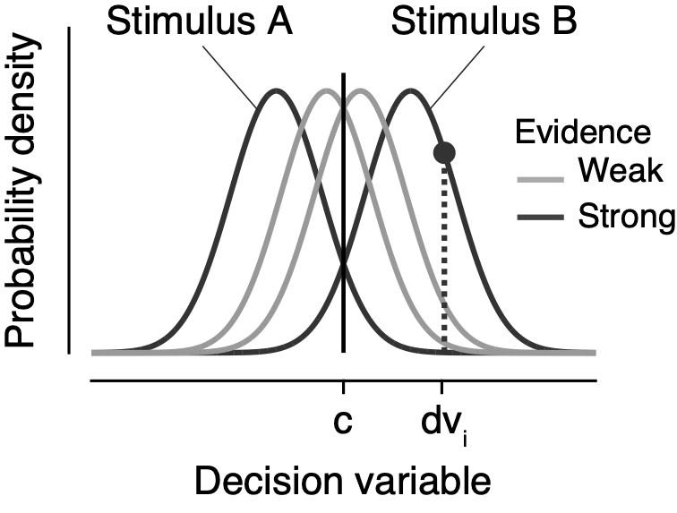
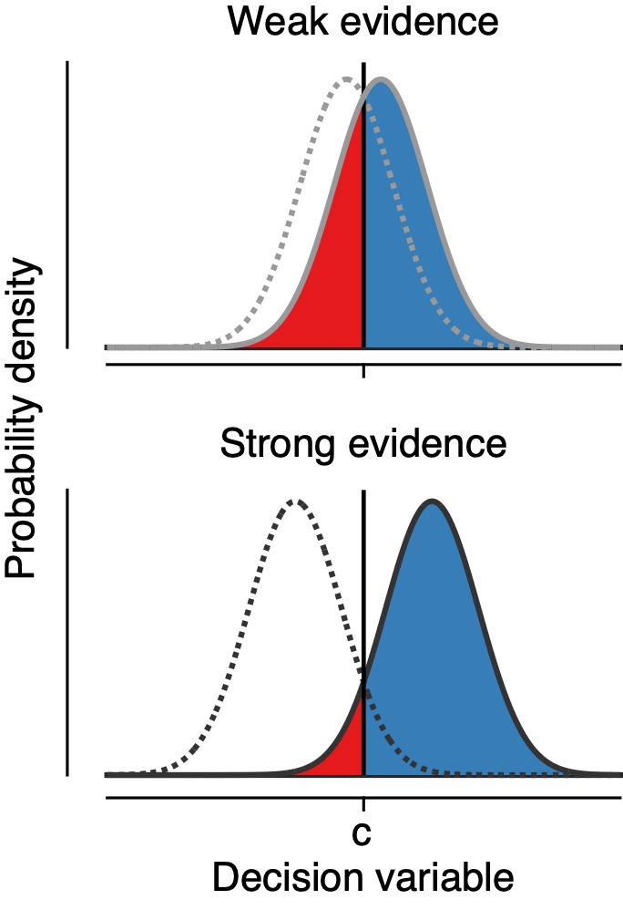
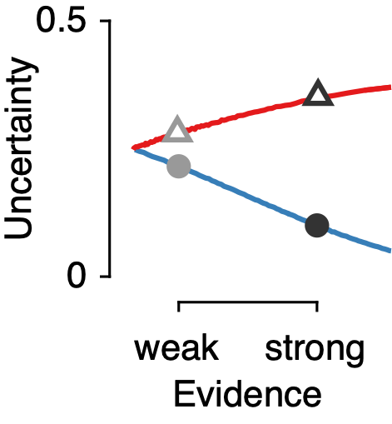
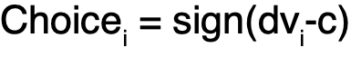
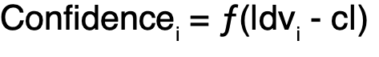
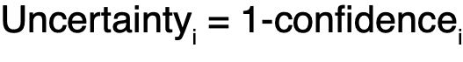
Decision uncertainty
Notes:
definition of decision uncertainty derived from SDT.
Confidence is a monotonic function of the distance between dv and c (sigmoid)

Slide 20
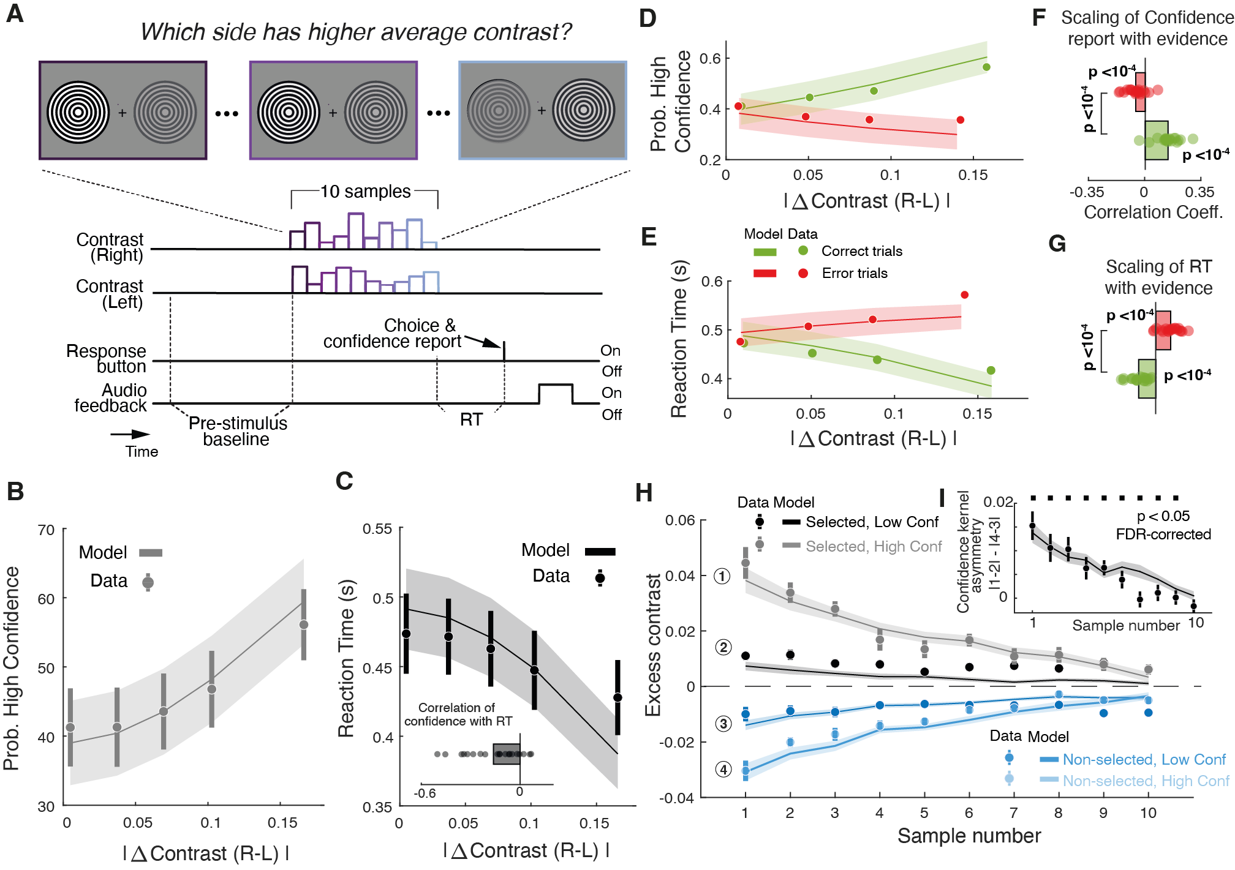
Decision uncertainty
Tosso et al (2025)

Slide 21
Detection vs Discrimination
Same treatment in SDT (Noise=Stim1 ; Signal+Noise=Stim2).
Critical difference: in Detection, the task-relevant axis is ‘DC’ (more vs less overall neural activity). In Discrimination, the task-relevant axis is ‘differential’ (larger vs smaller values of the difference in activity between relevant neural channels)
Discrimination is more robust to unspecific noise sources and overall tendencies to response
Notes:
Discrimination (~ common mode rejection).

Slide 22
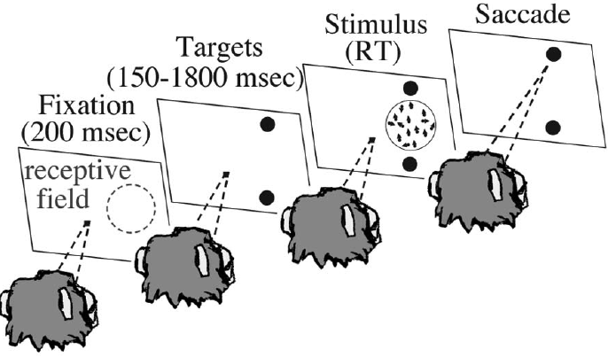
Motion discrimination task
Forced choice between two categories (e.g. LEFT vs. RIGHT motion).
Variable stimulus duration (= RT): animal decides how long it watches the stimulus before responding.
Rewarded for correct responses.
Newsome et al., 1989; Britten et al 1996; Shadlen et al 1996; Zohary et al 1994;

Slide 23
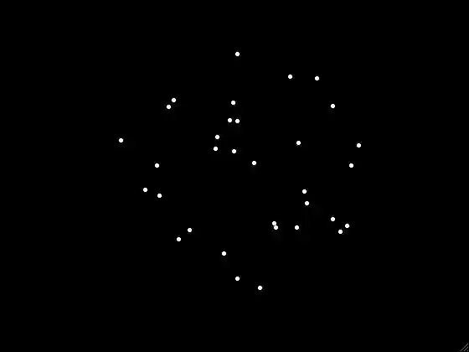
Motion discrimination task
Coherence = 0.5

Slide 24
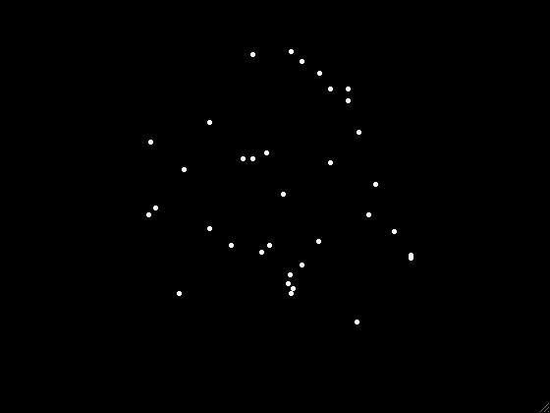
Motion discrimination task
Coherence = 0.1

Slide 25
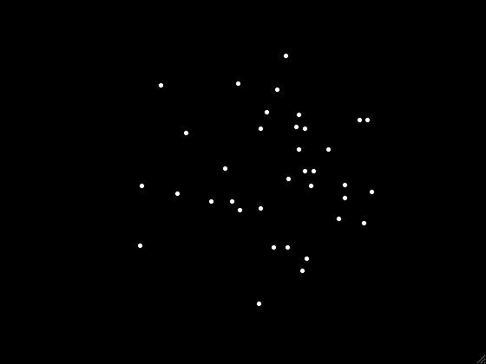
Motion discrimination task
Coherence = 0

Slide 26
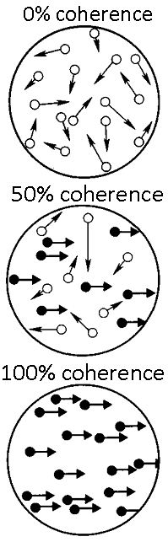
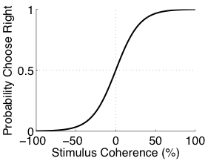
Motion discrimination task
c = 30 %
coherence = -100 %
0 %
5 %
100 %

Slide 27
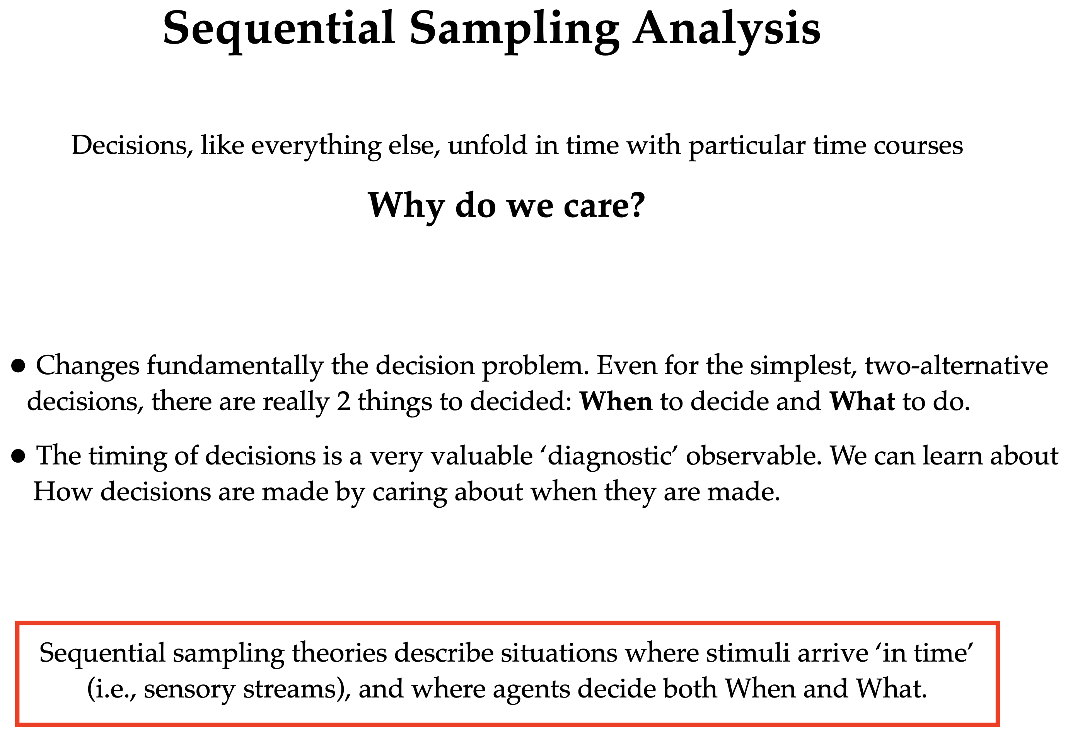

Slide 28
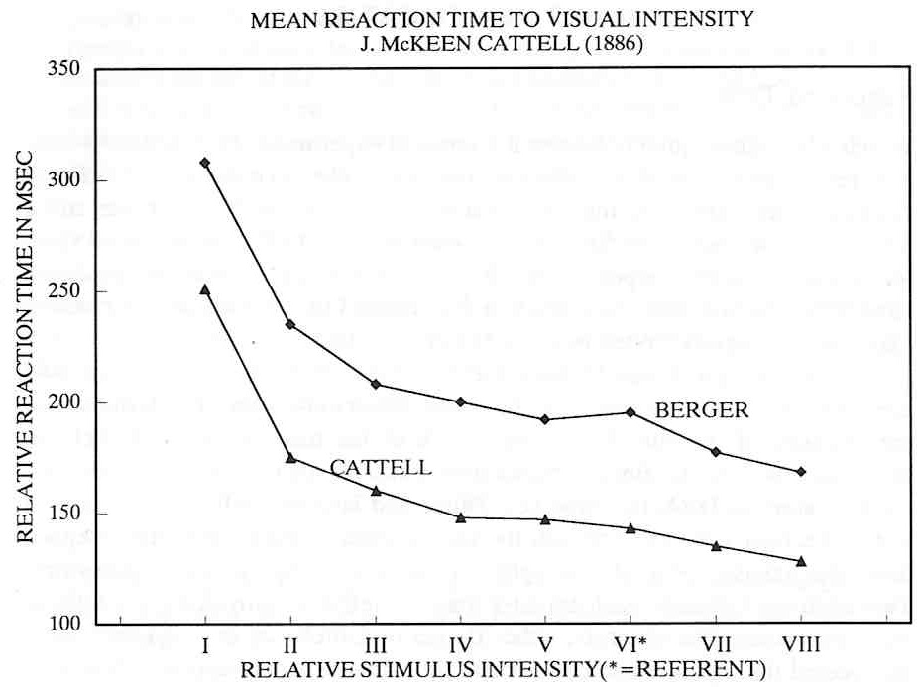
History
Cattell, 1886
RT is inversely related to Accuracy
The trade-off between speed and accuracy is the fundamental lawful relationship in sequential sampling.
How does it come about?

Slide 29

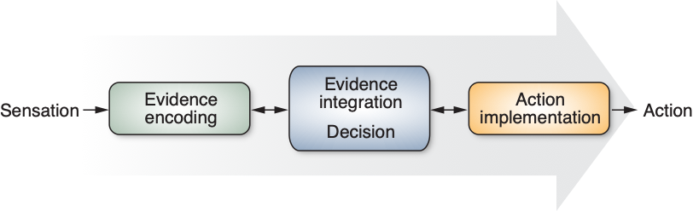
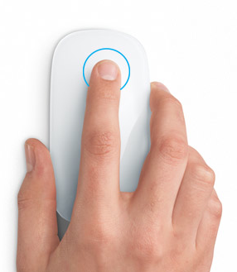
Response times: arising from processing stages
(Donders 1869, Sternberg 1969)

Slide 30
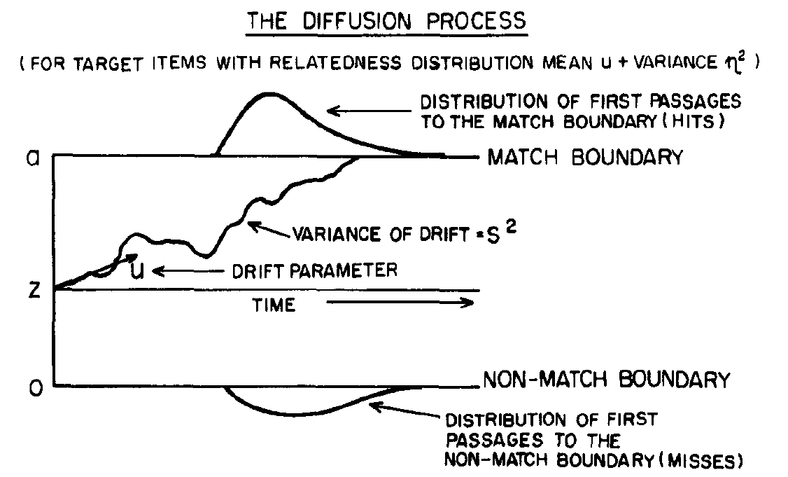
Sequential sampling models
SSMs posit that the brain makes decisions by sampling noisy evidence over time, up to a threshold.
Multiple model variants, e.g. relative vs absolute evidence accumulation
Diffusion decision model (DDM) is the most popular, introduced by Roger Ratcliff (1978)
aka ‘Drift Diffusion Model’, depending on who you ask
Ratcliff R (1978) A theory of memory retrieval. Psychological Review 85:59.

Slide 31
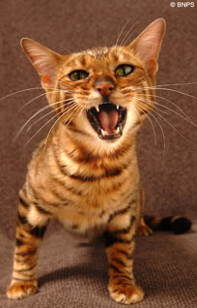
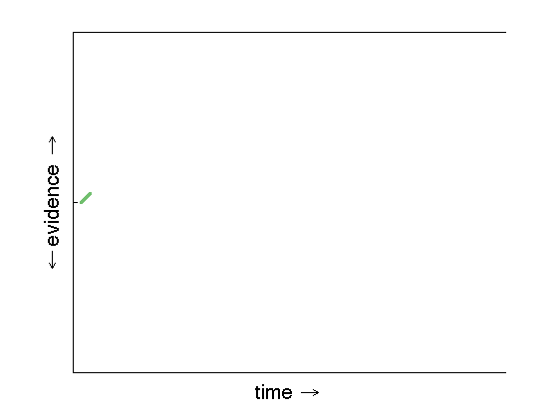
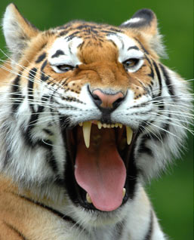
Notes:
Let’s put this idea in a picture. Time, or the number of possible codes tried out, elapses from left to right. This line at the top indicates that the code is a good one, for example decoding the message ‘retreat immediately’ that the Germans might be sending each other. The line at the bottom indicates that the code is worthless, and gives you only random messages.
Each time the code breakers would try a code on a new piece of text, they would assign a value to the outcome; positive if it resembled German words, negative if it was nonsense. If there was a perfect German word the evidence would be higher than if the code gave an almost-German word with still some mistakes in it.
Turing had the insight to integrate, or add together over time, this evidence. For each next word that the code breakers tried, the evidence was added up with what was already there. When the code was a good one, the evidence would steadily go up as more messages are decoded. For a bad code, the integrated evidence steadily went down. What Turing decided is that it would be good to have a fixed boundary, indicated by the lower and upper lines, on the amount of evidence they would gather. Until the evidence hits one of the two lines, you keep trying; when it does, you know whether this code is useful or not. Mathematically, we can show this this process of adding up the evidence results in the best possible decisions when you are faced with noise. In fact, the idea of integration is that you average out the noise, and are left with the signal you’re interested in.

Slide 32
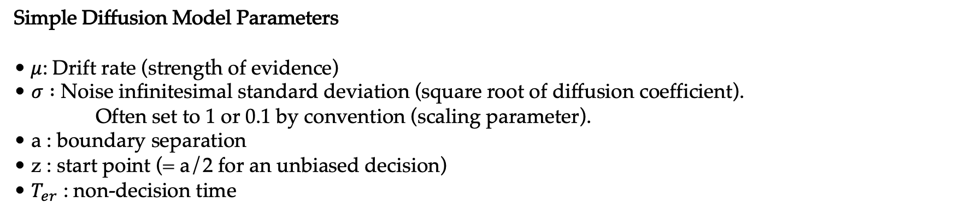
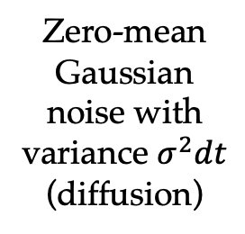
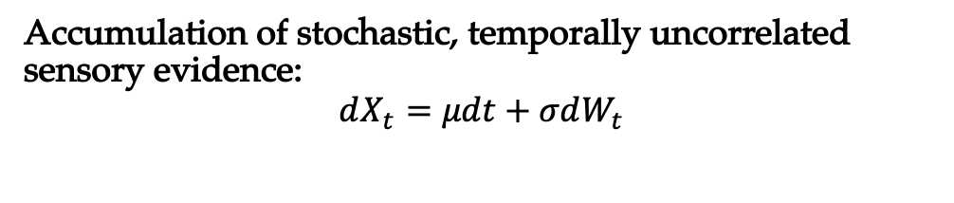
The Drift Diffusion Model
Correct
Accumulation of stochastic, temporally uncorrelated sensory evidence:
$$dX_{t}=μdt+σdW_{t}$$
a
+a
‘decision variable’
Zero-mean Gaussian noise with variance $σ^{2}dt$
(diffusion)
-a
Evidence accumulation
0
Error
Simple Diffusion Model Parameters
•$μ$: Drift rate (strength of evidence)
• $σ :$ Noise infinitesimal standard deviation (square root of diffusion coefficient). Often set to 1 or 0.1 by convention (scaling parameter).
• a : boundary separation
• z : start point (= a/2 for an unbiased decision)
• $T_{er}$ : non-decision time
$$RT=t_{D}+t_{ND}$$
‘non-decision time’ sensory encoding and motor delays

Slide 33
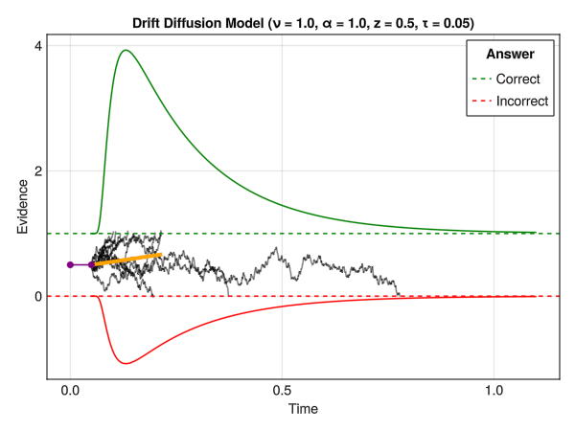
The Drift Diffusion Model
Each parameter uniquely affects RT distributions and accuracies.
For each set of parameters (i.e. for each experimental condition), we obtain a choice probability P(Correct) and two predicted RT distributions: correct and error responses (or left vs right responses).
This can be compared to the observed experimental data, with the goal of finding the best parameter set to explain the data (Model estimation).
Selective influence: an experimental manipulation that influences just a single parameter—all other parameters can be shared across the conditions.
Often desired, not always achieved.
https://dominiquemakowski.github.io/CognitiveModels/4b_rt_generative.html

Slide 34
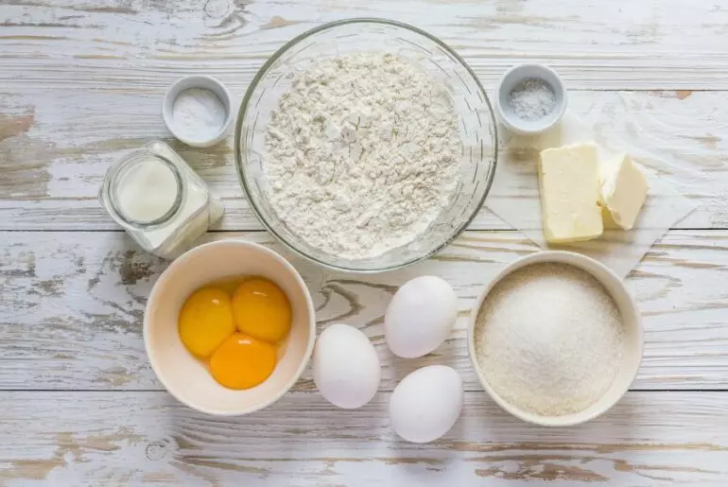
The DDM’s ingredients

Slide 35


DDM ingredients: evidence strength
time
Notes:
Such build-up of information is also what your brain does when faced with a foggy forest: rather than making a blink-of-an-eye decision, it adds up information over some time. In this graph, the upper bound means you just saw a cat and can relax, whereas the lower boundary indicates you’d better run very fast. On a sunny day, there is not much noise and the cat evidence builds up fast. However, if you can’t see the cat very well, as in this light-green trace, you might take longer to integrate enough evidence. If there’s a tiger, on the other hand, the evidence will go towards the other boundary in this red trace.
Evolutionarily, this method gives you the advantage of making an informed choice based on all the information out there in the world, rather than running for your life each time you hear something behind you.The beauty of this methods is that it’s optimal in a very precise sense: if there is limited information available in noise, then by accumulating evidence you average out the noise and make the best possible decision.

Slide 36

Changing evidence strength
Palmer et al. 2005

Slide 37

DDM ingredients: boundary adjustment
time
Notes:
Let’s go to the last example. One important missing piece of the puzzle so far, is that it would always take the same amount of time to integrate our evidence. But what if you’re in a hurry, and need quick decision making? The easiest solution here is to change your decision bound. So far, we have always seen this same solid line where the evidence integration stops. However, when you need quick decision making, you can use this dotted line here instead: because less evidence is needed, your decision will be reached faster. Research has shown that in all kinds of situations, people can be flexible in how much evidence they accumulate if their goal changes from making less mistakes to being faster.
A very real-life example of this is behaviour in traffic. If you’re driving or cycling and it’s raining, you should increase your decision bound and integrate more information before you decide whether to go left or right. In other words, when there is a lot of noise in the world, it might be better to be more cautious. If you are late for an appointment, however, you might not take your time and decide sooner, with the risk of making a mistake.

Slide 38

Speed-accuracy trade-off
Palmer et al. 2005
Desender et al 2019

Slide 39

DDM ingredients: starting point
time
Notes:
Another good example of what we can do with this model, is changing the starting point for one of the options. Some of you might have wondered if it’s not weird that you need the same amount of evidence to decide for a tiger and a cat; clearly, in this example it’s better to be cautious and be quicker if there is only a small chance you might face a tiger. In the model, this is quite simply done by changing the point at which we start the evidence integration: as you can see in this picture, we start the integration closer to the tiger bound, so that we’re quicker to recognise the tiger than the cat. In other words, the tiger needs less evidence before it is chosen, since we would rather run a few times when there’s a cat than relax once when there’s a tiger.

Slide 40
Motion discrimination task
Coherence = 0.1

Slide 41
Motion discrimination task
- This arrow (stimulus precue) predicts the motion direction only in 75% of the trials.
- It creates an unbalanced prior expectation in the subject that can be leverared to increase response accuracy.

Slide 42


Decision biases
Urai, de Gee, Tsetsos & Donner, eLife (2019)
Notes:
Don’t apologize for equations!

Slide 43


DDM ingredients: non-decision time
In the simple diffusion model, non-decision time is determined by a single parameter: ${t_{ND}= T}_{er}$ (time for encoding and response).
$RT=t_{D}+t_{ND}$
Usually assumed to be constant across stimulus discriminability levels, speed-accuracy instructions (but not always! See Donkin et al)
Having a high discriminability condition can be important for accurate estimation
Encode
Sensory Information
Plan & Execute
Action
Not the most realistic, evidence for continuous flow to the motor system

Slide 44
Theoretical Bases of the Drif Difussion Model

Slide 45
Inference “Urns game”
- Each urn has a different fraction of red and green balls.
- One urn is chosen randomly and balls are extracted sequentially from it.
Urn H0
Urn H1
80:20
20:80
- How many balls should I extract to infer the urn chosen is H0 or H1?
Mask
x₄
x₃
x₂
x₁

Slide 46
N=10
N=3
N=1
- How many balls should I extract to infer the urn chosen is H0 or H1?
- Answer: Depends on how accurate I want to be in my decision.

Slide 47

Bayes Theorem
$$p(A,B)=P(A)P(B|A)$$
$$p\left(A,B\right)=P\left(A\right)P\left(B | A\right)=P\left(B\right)P\left(A | B\right)$$
$$p(A|B)=\frac{P(A)P(B|A)}{P(B)}$$

Slide 48


$$p(A|B)=\frac{P(A)P(B|A)}{P(B)}$$
Urn 0
Ball observation
$$p(H_{0}|x)=\frac{P(H_{0})P(x|H_{0})}{P(x)}$$

Slide 49



Prior
likelihood
Posterior probability
$$p\left(H_{0} | x_{1},x_{2}, …{,x}_{N}\right)=\frac{P(H_{0})P(x_{1},x_{2}, …{,x}_{N}|H_{0})}{P(x_{1},x_{2}, …{,x}_{N})}$$
$$p\left(H_{1} | x_{1},x_{2}, …{,x}_{N}\right)=\frac{P(H_{1})P(x_{1},x_{2}, …{,x}_{N}|H_{1})}{P(x_{1},x_{2}, …{,x}_{N})}$$
Probability Ratio:
$$\frac{p\left(H_{0} | x_{1},x_{2}, …{,x}_{N}\right)}{p\left(H_{1} | x_{1},x_{2}, …{,x}_{N}\right)}=\frac{P(H_{0})P(x_{1},x_{2}, …{,x}_{N}|H_{1})}{P(H_{1})P(x_{1},x_{2}, …{,x}_{N}|H_{1})}$$

Slide 50


Log Probability Ratio:
$$LLR=log\left(\frac{P(H_{0})P(x_{1},x_{2}, …{,x}_{N}|H_{1})}{P(H_{1})P(x_{1},x_{2}, …{,x}_{N}|H_{1})}\right)=$$
Prior
Log likelihood = evidence e_{i}
$$=log\left(\frac{P(H_{0})}{P(H_{1})}\prod_{i=1}^{N}{\frac{P(x_{i}|H_{1})}{P(x_{i}|H_{1})}}\right)=log\frac{P(H_{0})}{P(H_{1})}+\sum_{i=1}^{N}{\log{\frac{P(x_{i}|H_{1})}{P(x_{i}|H_{1})}}}$$

Slide 51








Sequential Probability Ratio Test (SPRT)
Wald, 1947; Wald & Wolfowitz, 1948
We have two hypotheses H₀ and H₁
Consider N sequential observations
A sequential decision strategy is a set of decision functions
{
Decision Rule (SPRT)
H0 if
S* =
H1 if
The decision bounds determine
the probability of making an error
W if
The SPRT is optimal in the sense of having the least
Expected “decision time” for a given error rate

Slide 52


Sequential Probability Ratio Test (SPRT)
$${LLR}_{N}=log\frac{P(H_{0})}{P(H_{1})}+\sum_{i=1}^{N}{\log{\frac{P(x_{i}|H_{1})}{P(x_{i}|H_{1})}=E_{0}+e_{1}+}e_{2}+…e_{N}}$$
At every time-step, accumulate LRi until A,B
Update running count of the Log Likelihood Ratio
Receive an observation (data sample)
Wald, 1947; Wald & Wolfowitz, 1948

Slide 53

Inference “Urns game”
Urn H0
Urn H1
80:20
30:70
P(red-ball | H0) = 0.8
P(green-ball | H0) = 0.2
P(red-ball | H1) = 0.3
P(green-ball | H1) = 0.7
e₁
e₂
e₃
0.2
0.8
0.8
= + + + …
Mask
0.7
0.3
0.3
e₄
e₃
e₂
e₁

Slide 54

Sequential Probability Ratio Test (SPRT)
Wald, 1947; Wald & Wolfowitz, 1948
Choose H0
Accumulated evidence for H0 over H1
Mean drift rate = mean of LRi
(which reflects strength of evidence
Choose H1
The rate of accumulation depends on the strength of the evidence
The thresholds depend on the error rate we want to achieve. Upon hiting the bound, by definition, the probability
of a correct choice is the same regardless of the evidence strength.
For given evidence strength, better decisions require more time
Speed-Accuracy Trade-Off (SAT) !!
For a given accuracy, lower evidence strength also takes more time

Slide 55
How about the brain? Does it also accumulate evidence to the bound?

Slide 56

Neural Bases of Accumulation-to-bound Models
0 %
5 %
100 %

Slide 57

How about the brain?
Urai AE, de Gee JW, Tsetsos K, Donner TH (2019) Choice history biases subsequent evidence accumulation. eLife 8:e46331.

Slide 58



Medial Temporal Cortex (MT)
MT neuron in behaving monkey
Evidence
Firing rate (spk/s)
high
medium
low
Motion direction
Gold JI, Shadlen MN (2007) The Neural Basis of Decision Making. Annual Review of Neuroscience 30:535–574.
Notes:
Visual motion centers in the back of the brain are like the code breakers of the enigma. Some neurons will fire more for left, others more for rightwards motion. Here, you see the activity of a neuron that has a higher activity for motion towards the right. You see that for all right-moving images, there is more response than for images that move towards the left.
More importantly, the activity of this neuron is related to the amount of evidence available. The orange lines, indicating the highest neural activity, are for images with high evidence - a tiger running towards your right really fast, on a sunny. Red and blue lines are for less evidence, perhaps seeing it move slower, a bit further away from you or when it’s raining.

Slide 59


Shadlen’s model of perceptual decision making
$$D= X_{UP}− Y_{DOWN}= \frac{1}{N}\left(\sum_{i=1}^{N}{x_{i }−\sum_{i=1}^{N}{y_{i } }}\right)$$
x₁ x₂
x_{N}
Response rate
+
…
+
X_{UP}
r = 0.18
D < 0
y₁ y₂
y_{N}
…
+
−
Y_{DOWN}
Shadlen et al 1996, Haefner et al 2012
Shadlen et al 1996
Notes:
Shadlen’s model & Correlations: choice probability requires correlated variability
Michael Shadlen and colleagues proposed a simple feed-fwd model of population coding and decision making that to a very large extend has shaped the way the people in the field think about the mechanisms behind perceptual decision making.
The essence of the model is illustrated in this simple version in which 2 MT populations with opposite preferred motion direction respond to RDMP in an stochastic manner with the response rate being determined by the stimulus coherence. The response of each population is pooled and compared and the outcome of this simple comparison determines the decision. Therefore any relation between sensory activity and the decision has a causal origin in this model.
The key finding of the model was to show that CP decreases with pool size and asymptotes to CHANCE (0.5) is neurons in each pool are independent or to NON-CHANCE value if neurons within the pools were correlated.
Leaves open the question of the source of co-variaibtiliy.
Not described in the model:
1. Sources of (co-)variability.
2. Dynamics of perceptual decision making.
Sources of neuronal co-variability - Irreducible co-variations of spike counts caused by shared inputs
However, I will show you next, that this result is not a general property in recurrently and randomly connected networks.

Slide 60

Shadlen’s model of perceptual decision making
x₁ x₂
x_{N}
Response rate
+
…
+
X_{UP}
r = 0.18
DV(t)$= \int_{0}^{t}{\left(\sum_{i=1}^{N}{x_{i }(t′)−\sum_{i=1}^{N}{y_{i }(t′) }}\right)dt′}$
y₁ y₂
y_{N}
…
+
−
Y_{DOWN}
Shadlen et al 1996, Haefner et al 2012
Shadlen et al 1996
Notes:
Shadlen’s model & Correlations: choice probability requires correlated variability
Michael Shadlen and colleagues proposed a simple feed-fwd model of population coding and decision making that to a very large extend has shaped the way the people in the field think about the mechanisms behind perceptual decision making.
The essence of the model is illustrated in this simple version in which 2 MT populations with opposite preferred motion direction respond to RDMP in an stochastic manner with the response rate being determined by the stimulus coherence. The response of each population is pooled and compared and the outcome of this simple comparison determines the decision. Therefore any relation between sensory activity and the decision has a causal origin in this model.
The key finding of the model was to show that CP decreases with pool size and asymptotes to CHANCE (0.5) is neurons in each pool are independent or to NON-CHANCE value if neurons within the pools were correlated.
Leaves open the question of the source of co-variaibtiliy.
Not described in the model:
1. Sources of (co-)variability.
2. Dynamics of perceptual decision making.
Sources of neuronal co-variability - Irreducible co-variations of spike counts caused by shared inputs
However, I will show you next, that this result is not a general property in recurrently and randomly connected networks.

Slide 61

x₁ x₂
x_{N}
Drift Diffusion model
…
+
+
X_{UP}
UP boundary
D < 0
r = 0.18
y₁ y₂
y_{N}
DOWN boundary
…
+
−
time
Y_{DOWN}
Shadlen et al 1996, Ratcliff & Rouder 1998
Notes:
Shadlen’s model & Correlations: choice probability requires correlated variability
Michael Shadlen and colleagues proposed a simple feed-fwd model of population coding and decision making that to a very large extend has shaped the way the people in the field think about the mechanisms behind perceptual decision making.
The essence of the model is illustrated in this simple version in which 2 MT populations with opposite preferred motion direction respond to RDMP in an stochastic manner with the response rate being determined by the stimulus coherence. The response of each population is pooled and compared and the outcome of this simple comparison determines the decision. Therefore any relation between sensory activity and the decision has a causal origin in this model.
The key finding of the model was to show that CP decreases with pool size and asymptotes to CHANCE (0.5) is neurons in each pool are independent or to NON-CHANCE value if neurons within the pools were correlated.
Leaves open the question of the source of co-variaibtiliy.
Not described in the model:
1. Sources of (co-)variability.
2. Dynamics of perceptual decision making.
Sources of neuronal co-variability - Irreducible co-variations of spike counts caused by shared inputs
However, I will show you next, that this result is not a general property in recurrently and randomly connected networks.

Slide 62
How about the brain?
Urai AE, de Gee JW, Tsetsos K, Donner TH (2019) Choice history biases subsequent evidence accumulation. eLife 8:e46331.

Slide 63

Gold JI, Shadlen MN (2002) Banburismus and the Brain. Neuron 36:299–308.
Notes:
Visual motion centers in the back of the brain are like the code breakers of the enigma. Some neurons will fire more for left, others more for rightwards motion. Here, you see the activity of a neuron that has a higher activity for motion towards the right. You see that for all right-moving images, there is more response than for images that move towards the left.
More importantly, the activity of this neuron is related to the amount of evidence available. The orange lines, indicating the highest neural activity, are for images with high evidence - a tiger running towards your right really fast, on a sunny. Red and blue lines are for less evidence, perhaps seeing it move slower, a bit further away from you or when it’s raining.

Slide 64





LATERAL INTRAPARIETAL CORTEX (LIP)
-1000 -500 0
Time from response (s)

Slide 65

Evidence
high
medium
low
Gold JI, Shadlen MN (2007) The Neural Basis of Decision Making.
Annual Review of Neuroscience 30:535–574.
Notes:
After this step of code-breaking we come to Turing’s solution of integrating this evidence over time. As it turns out, areas in the parietal cortex in the brain, here in purple, constantly receive information from the visual centers, and they integrate this information over time. At the bottom of this figure, you see the visual activity that we just saw, for the different levels of evidence. The top of the figure shows neurons from the parietal cortex, which reflect the integrated activity displayed at the bottom. Just as we saw in our evidence integration movies before, the build-up is fastest when there is a lot of evidence, and a bit slower for the medium and low evidence images. The red and blue traces contain more noise that needs to be averaged out over time. This will lead to a slower decision, but still to the correct answer.
In Turing’s case, hitting one of the two thresholds meant that the codebreakers could switch tasks. For the brain, this threshold usually means that you can start performing an action - when you’ve decided where the tiger is going, your legs will start to move in the opposite direction.

Slide 66

Gold JI, Shadlen MN (2002) Banburismus and the Brain. Neuron 36:299–308.
Notes:
Visual motion centers in the back of the brain are like the code breakers of the enigma. Some neurons will fire more for left, others more for rightwards motion. Here, you see the activity of a neuron that has a higher activity for motion towards the right. You see that for all right-moving images, there is more response than for images that move towards the left.
More importantly, the activity of this neuron is related to the amount of evidence available. The orange lines, indicating the highest neural activity, are for images with high evidence - a tiger running towards your right really fast, on a sunny. Red and blue lines are for less evidence, perhaps seeing it move slower, a bit further away from you or when it’s raining.

Slide 67
O’Connell RG, Shadlen MN, Wong-Lin K, Kelly SP (2018) Bridging Neural and Computational Viewpoints on Perceptual Decision-Making. Trends in Neurosciences 41:838–852.

Slide 68
Gracias

